Slide 1

ARTIFICIAL INTELLIGENCE
&
MACHINE LEARNING
SESSION NO :3
Intelligent Agents & PEAS framework
Rational agents, agent environments, PEAS examples.

Slide 2
Agent
What’s an Agent?
An agent is anything that perceives its environment and acts upon it.
Not all agents are intelligent — some follow fixed rules or blindly respond to input.

Slide 3
Agent
Agent | Perceives (Sensors) | Acts (Actuators) | Why it’s not intelligent
🔘 Thermostat | Room temperature sensor | Switches heating/cooling ON or OFF | Simple condition-action rule. No learning or reasoning.
🧹 Basic Vacuum Cleaner | Physical bump sensors | Motor for suction and movement | Randomly moves; no environment understanding.
🧭 Automatic Street Light | Light sensor | Turns light ON/OFF | Doesn’t adapt or optimize. Just responds to brightness.

Slide 4
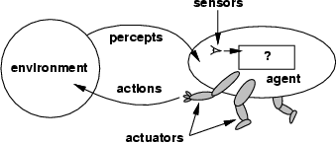
Agents
An agent is anything that can be viewed as:
  perceiving its environment through sensors and
  acting upon that environment through actuators
  Assumption: Every agent can perceive its own actions (but not always the effects)

Slide 5
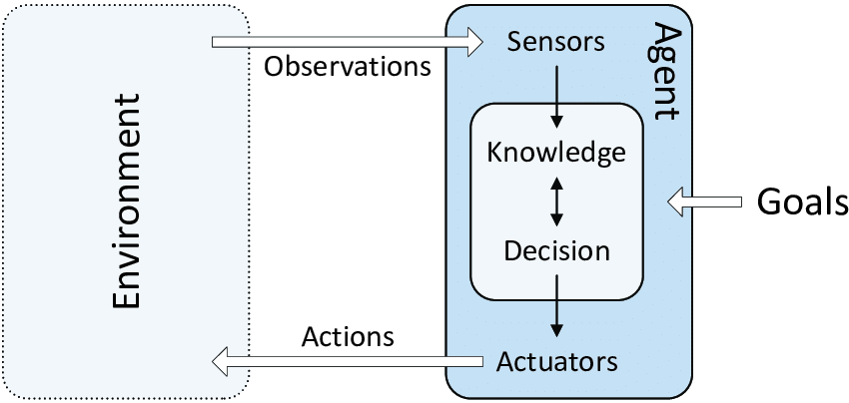

Slide 6
Agent Terminologies
Percept – input sensed at a moment
Percept Sequence – full history of percepts
Agent Function – Maps percept sequence → action
Agent Program – Concrete implementation (code) of agent function
Agent = Agent Program + Architecture

Slide 7
Agent function
A mathematical formula called the agent function converts a series of observations into actions.
The function is implemented as the agent program.
Actuator refers to the component of an agent that performs an action.
environment → sensors → agent function → actuators → environment

Slide 8
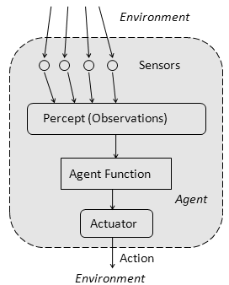

Slide 9
Agent Function | Agent Program
Theoretical | Practical
Mathematical mapping | Actual software
Based on all percept sequences | Based on current percept

Slide 10
Intelligent Agent
Intelligent Agents:
An intelligent agent is one that chooses the best action to achieve goals based on percepts, knowledge, and learning.

Slide 11
Intelligent Agent | Perceives | Acts
🚗 Self-Driving Car (e.g., Tesla) | Cameras, radar, GPS, LIDAR | Steering, braking, accelerating
🤖 Smart Vacuum (e.g., Roomba) | Camera, dirt sensor, wall sensors | Navigates, sucks dirt, avoids obstacles
🎯 Spam Filter (e.g., Gmail) | Email content, sender history | Moves email to inbox or spam
🧠 Google Assistant / Alexa | Voice input, device context | Plays music, sets reminders, answers questions
🍔 Zomato/Swiggy Recommender | User preferences, time of day, location | Suggests food/restaurants
🛍️ Amazon Product Recommendation Bot | Browsing history, purchases, ratings | Recommends relevant products

Slide 12
Intelligent Agent | Perceives | Acts | Why it's intelligent
🚗 Self-Driving Car (e.g., Tesla) | Cameras, radar, GPS, LIDAR | Steering, braking, accelerating | Analyzes traffic, predicts pedestrian movement, optimizes routes.
🤖 Smart Vacuum (e.g., Roomba) | Camera, dirt sensor, wall sensors | Navigates, sucks dirt, avoids obstacles | Remembers layout, avoids falls, learns high-dirt areas.
🎯 Spam Filter (e.g., Gmail) | Email content, sender history | Moves email to inbox or spam | Learns over time, adapts to new spam tactics.
🧠 Google Assistant / Alexa | Voice input, device context | Plays music, sets reminders, answers questions | Understands natural language, personalizes experience.
🍔 Zomato/Swiggy Recommender | User preferences, time of day, location | Suggests food/restaurants | Learns from user behavior, adapts to context.
🛍️ Amazon Product Recommendation Bot | Browsing history, purchases, ratings | Recommends relevant products | Learns user preferences, updates in real time.

Slide 13
Intelligent Agent
Agent: element in a system or environment that can trigger action.
When deciding what to do, an agent makes decisions based on how they perceive their surroundings.
The perception capability is usually called a sensor.
The most recent perception or the full history (percept sequence) may influence the actions.

Slide 14
Rational agent
A rational agent is one who can make the best choice in any circumstance.
Rational Agent
Maximizes expected performance
Considers:
  Performance measure
  Percepts so far
  Prior knowledge
  Available actions

Slide 15
Vaccum cleaner agent
Let’s assume the following
  The performance measure awards one point for each clean square
  at each time step, over a lifetime of 1000 time steps
  The geography of the environment is known a priori but the dirt distribution and the initial location of the agent are not. Clean squares stay clean and the sucking cleans the current square. The Left and Right actions move the agent left and right except when this would take the agent outside the environment, in which case the agent remains where it is
  The only available actions are Left, Right, Suck and NoOp
  The agent correctly perceives its location and whether that location contains dirt
Under these circumstances the agent is rational: its expected performance is at least as high as any other agent’s

Slide 16
Vaccum cleaner agent
Same agent would be irrational under different circumstances:
  Once all dirt is cleaned up it will oscillate needlessly back and forth.
  If the performance measure includes a penalty of one point for each movement left or right, the agent will fare poorly.
  A better agent for this case would do nothing once it is sure that all the squares are clean.
If the clean squares can become dirty again, the agent should occasionally check and clean them if needed.
If the geography of the environment is unknown the agent will need to explore it rather than stick to squares A and B

Slide 17
Agent types
Four basic types in order of increasing generality:
Rather than a table how we can produce rational behavior from a small amount of code
  Simple reflex agents
  Model-based reflex agents
  Goal-based agents
  Utility-based agents

Slide 18

Example: vaccum-agent
Percepts:
  Location and status, e.g., [A,Dirty]
Actions:
  Left, Right, Suck, NoOp
function Vacuum-Agent([location,status]) returns an action
  if status = Dirty then return Suck
  else if location = A then return Right
  else if location = B then return Left

Slide 19
Simple reflex agents
Select actions on the basis of the current percept ignoring the rest of the percept history
Example: simple reflex vacuum cleaner agent
Condition-action-rule
Example: if car-in-front-is-breaking then initiate-breaking
function REFLEX-VACUUM-AGENT([location,status]) returns an action
if status = Dirty then return Suck
else if location = A then return Right
else if location = B then return Left

Slide 20
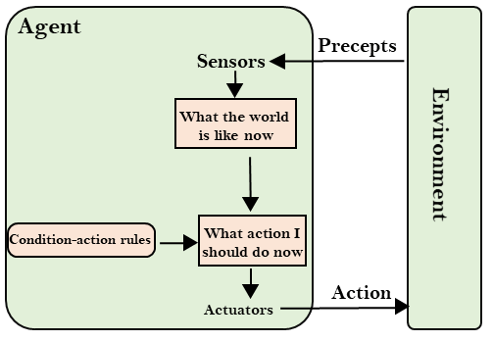
Simple reflex agents

Slide 21
Simple reflex agents
function SIMPLE-REFLEX-AGENT(percept) returns an action
static: rules, a set if condition-action rules state <-- INTERPRET_INPUT(percept) rule <-- RULE_MATCH(state, rules) action <-- RULE_ACTION[rule]
return action
Simple-reflex agents are simple, but they turn out to be of very limited intelligence
The agent will work only if the correct decision can be made on the basis of the current percept – that is only if the environment is fully observable
Infinite loops are often unavoidable – escape could be possible by randomizing

Slide 22
Model-based reflex agents
It’s the more advanced version of the simple reflex agent it works by finding a rule which is suitable for the current situation.
It is given a model of the environment, as it can work depending on the previous situation too, it can use the model to work on a partially observable environment.

Slide 23
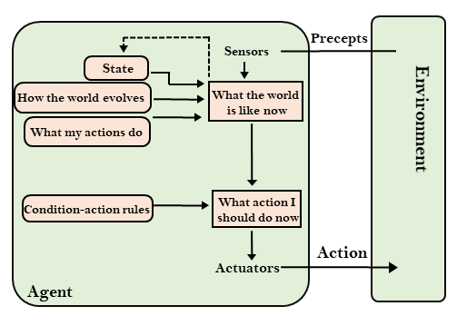
Model-based reflex agents

Slide 24
Goal-driven agents
These kinds of agents work on certain goals in order to minimize the time reaching it. It helps the model to accelerate things as here the model can simulate and choose what situation will be best to decrease the end time for reaching the goal. The knowledge that supports its decisions is represented explicitly and can be modified, which makes these agents more flexible. They usually require search and planning. The goal-based agent’s behavior can easily be changed.
.

Slide 25
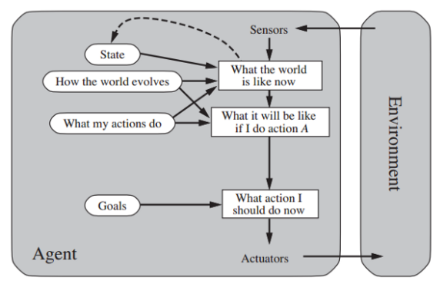

Slide 26
Utility-based agents: For these types of agents in Ai, the end goal for the Ai works as a foundation. For example, in a smart temperature control system here if the goal is keeping the temperature at 24 degrees centigrade, once it is reached it will stop cooling any further and when the temperature rises it will get started automatically. For the utility-based AI agent, there are multiple possible alternatives like for example,
Another place where a utility-based AI agent is used is a GPS system were reaching the destination is not enough it needs to be quick and convenient. Here the Utility-Based Ai agent will take these decisions keeping convenience in mind.

Slide 27
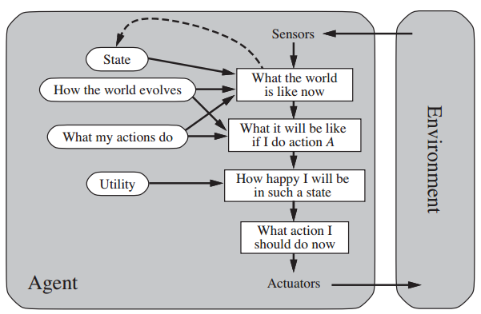

Slide 28
Learning agents
Agents with the capacity to learn new skills through observations and acts.
Components:
  Learning component (modifies the performance component)
  aspect of performance (selects actions)
  exploration element (problem generator) and
  feedback element (critic).

Slide 29
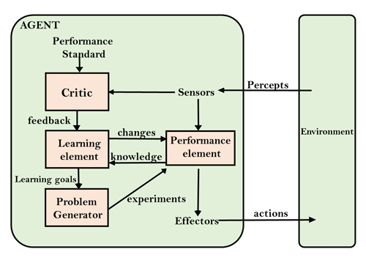

Slide 30
PEAS Representation in AI
PEAS is a framework used to specify the structure of an intelligent agent in AI.
It breaks down the agent's interaction with the environment into four key components:
  Performance Measure: The criteria that define the success of the agent's actions.
  Environment: The surroundings or the context in which the agent operates.
  Actuators: The mechanisms through which the agent interacts with the environment.
  Sensors: The tools the agent uses to perceive its environment.
By defining these elements, PEAS provides a clear outline for designing and evaluating intelligent systems, ensuring they are equipped to perform their tasks effectively.

Slide 31
P: Performance Measure
Performance measure is the unit to define the success of an agent. Performance varies with agents based on their different precepts.
Performance measure is a quantitative measure that evaluates the outcomes of an agent's actions against a predefined goal. The performance measure is crucial because it guides the agent's decision-making process, ensuring that it acts in a way that maximizes its success.
For example, in a self-driving car, the performance measure could include criteria such as safety (avoiding accidents), efficiency (minimizing travel time), and comfort (ensuring a smooth ride). The car's AI will aim to optimize these factors through its actions.

Slide 32
E: Environment
There are 5 major types of environments:
  Fully Observable & Partially Observable
  Episodic & Sequential
  Static & Dynamic
  Discrete & Continuous
  Deterministic & Stochastic

Slide 33
Fully Observable | Partially Observable
Agent has access to the entire state of the environment | Agent has limited or noisy view of the environment
No need for memory | Needs memory or inference
Simpler to design agents | Complex, needs models
xamples:
🎲 Chess Game (fully observable: board is visible)
🚗 Driving in traffic (partially observable: can't see behind buildings)

Slide 34
Episodic | Sequential
Agent’s experience is divided into independent episodes | Current decision affects future decisions
No need to remember past | Needs memory and planning
Easier to solve | More complex
Examples:
📸 Image classification (each image = separate task)
🏎️ Self-driving car (one turn affects the next)

Slide 35
Static | Dynamic
Environment does not change while the agent is deciding | Environment changes over time, even if agent is doing nothing
Time doesn’t matter much | Timing is critical
Easy to analyze | Harder to predict outcomes
Examples:
📃 Sudoku puzzle (static)
🎮 Real-time video games (dynamic)

Slide 36
Discrete | Continuous
Limited number of actions/percepts | Infinite or uncountable actions/percepts
Easy to model | Needs calculus or approximations
Usually symbolic | Usually numeric or sensory data
Examples:
♟️ Chess (discrete: fixed moves)
🚗 Robot Navigation (continuous: smooth movement, speed, angles)

Slide 37
Deterministic | Stochastic
Next state is completely predictable | Has randomness or uncertainty
Same action → same result | Same action → different possible outcomes
Less learning needed | Requires probabilities, learning
Examples:
🧮 Math solver (deterministic)
🎲 Rolling a die or weather prediction (stochastic)

Slide 38
A: Actuators
An actuator is a part of the agent that delivers the output of action to the environment.
They are responsible for executing the actions decided by the agent based on its perceptions and decisions. In essence, actuators are the "hands and feet" of the agent, enabling it to carry out tasks.
The actuators for a smart thermostat include the heating system, cooling system, and fans, which it controls to adjust the room temperature and maintain the desired comfort level.
The design and choice of actuators are crucial because they directly affect the agent's ability to perform its functions in the environment.

Slide 39
S: Sensors
Sensors are the receptive parts of an agent that takes in the input for the agent.
Sensors collect data from the environment, which is then processed by the agent to make informed decisions. Sensors are the "eyes and ears" of the agent, providing it with the necessary information to act intelligently.
The sensors for a smart thermostat include temperature sensors to measure the current room temperature, humidity sensors to detect moisture levels, and motion sensors to determine if people are present in the house.
The quality and variety of sensors used in an AI system greatly influence its ability to perceive and understand its environment.

Slide 40
Examples of PEAS in AI
Autonomous Vehicles
Robotic Vacuum Cleanerss
Game-Playing AI

Slide 41
Advantages of PEAS in AI
Structured Design: Provides a clear framework for designing intelligent agents by breaking down their components.
Versatility: Applicable to various AI systems, from simple bots to complex autonomous agents.
Goal-Oriented: Ensures that agents are designed with specific, measurable objectives, leading to better performance.
Systematic Development: Facilitates organized planning and development, making the process more efficient.

Slide 42
Disadvantages of PEAS in AI
Complexity: Can be complex to implement in dynamic environments with many variables.
Over-Simplification: Might oversimplify real-world scenarios, leading to gaps in agent behavior.
Resource-Intensive: Requires significant resources to accurately define and implement each PEAS component.
Limited Adaptability: May struggle to adapt to unexpected changes if not designed with enough flexibility.

Slide 43
Agent | Performance Measure | Environment | Actuator | Sensor
Hospital Management System | Patient's health, Admission process, Payment | Hospital, Doctors, Patients | Prescription, Diagnosis, Scan report | Symptoms, Patient's response
Automated Car Drive | The comfortable trip, Safety, Maximum Distance | Roads, Traffic, Vehicles | Steering wheel, Accelerator, Brake, Mirror | Camera, GPS, Odometer
Subject Tutoring | Maximize scores, Improvement is students | Classroom, Desk, Chair, Board, Staff, Students | Smart displays, Corrections | Eyes, Ears, Notebooks
Part-picking robot | Percentage of parts in correct bins | Conveyor belt with parts; bins | Jointed arms and hand | Camera, joint angle sensors
Satellite image analysis system | Correct image categorization | Downlink from orbiting satellite | Display categorization of scene | Color pixel arrays

